Slide 1
Retrieve Roads from Aerial Imagery Using Deep Learning
Capstone Project Data Presentation, CPLN 680, Spring 2021, UPenn
Jiamin Tan

Slide 2
Object
Learn how to train a neural network to detect roads from high resolution aerial images.

Slide 3
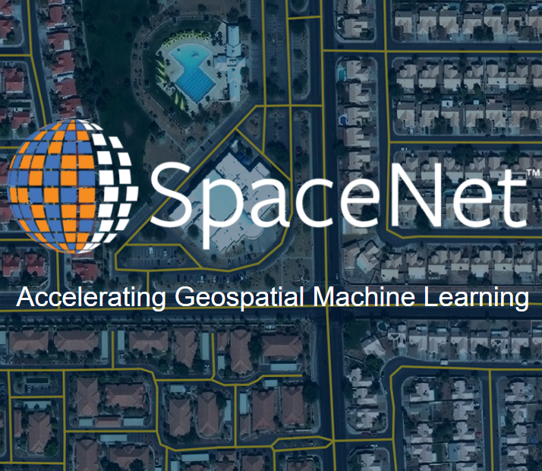
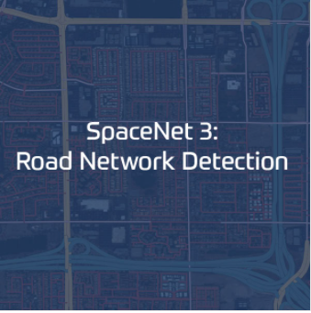
Main Data Source
https://spacenet.ai/

Slide 4
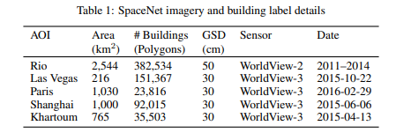
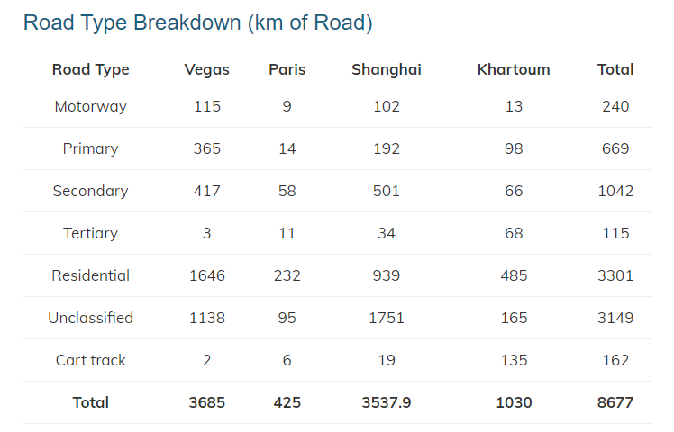
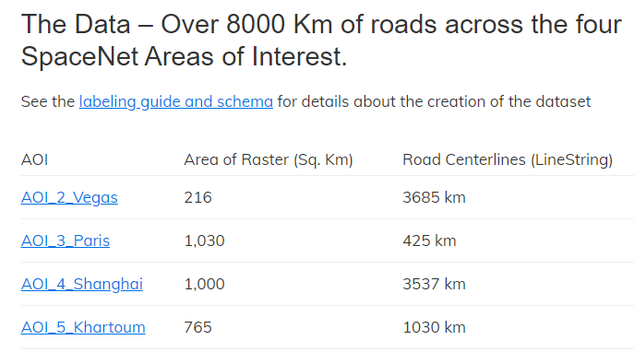
Dataset Overview
https://spacenet.ai/spacenet-roads-dataset/
Van Etten, A., Lindenbaum, D., & Bacastow, T.M. (2018). SpaceNet: A Remote Sensing Dataset and Challenge Series. ArXiv, abs/1807.01232.

Slide 5
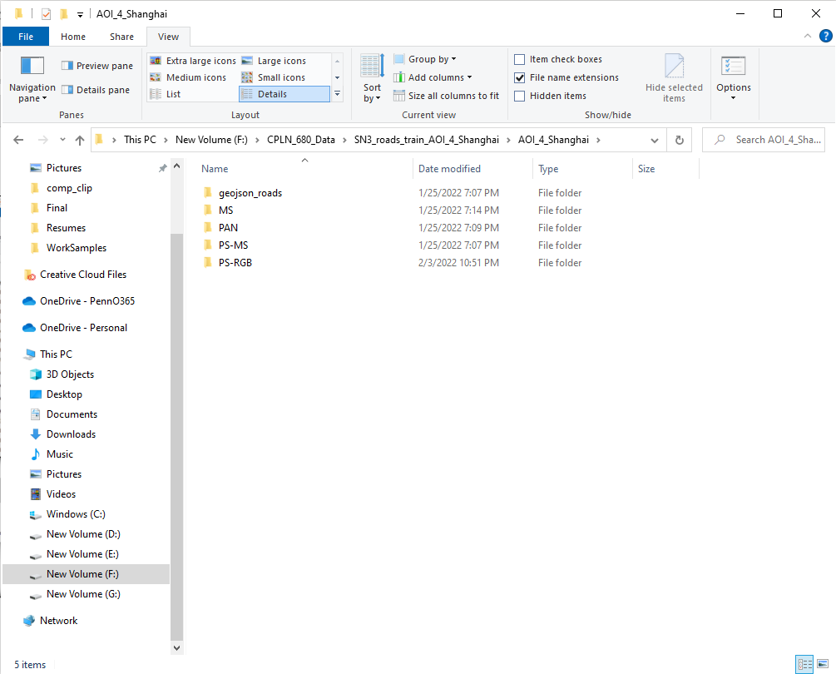
geojson_roads: ground truth labels
MS: Multi Spectral
PAN: Panchromatic
PS-MS: Pan-Sharpened Multi Spectral Imagery
PS-RGB: Pan-Sharpened RGB Imagery

Slide 6
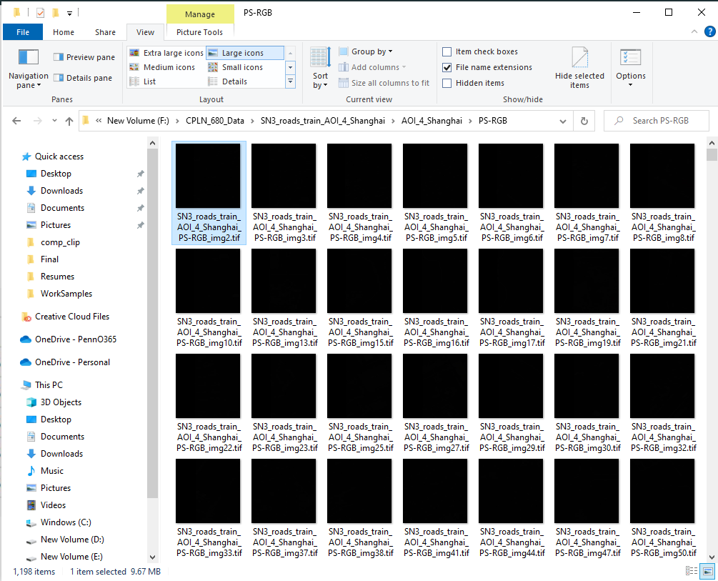
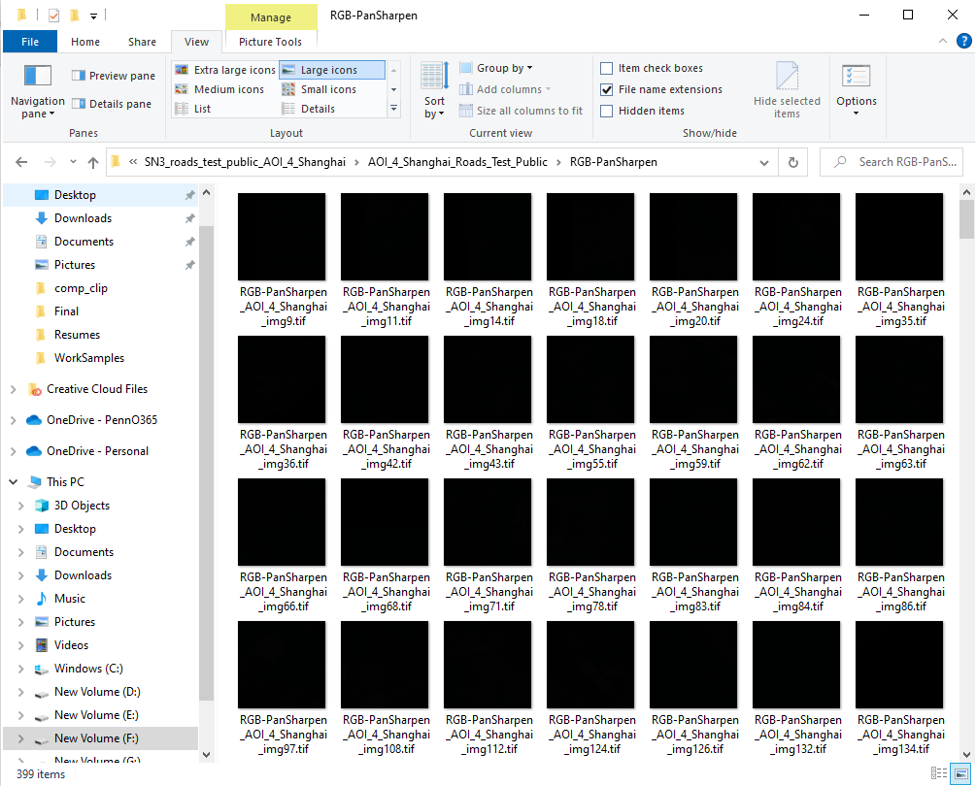

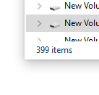
Training Images
Testing Images
The testing set does not come with labels
Recreate testing set by splitting the training set
https://spacenet.ai/spacenet-roads-dataset/

Slide 7
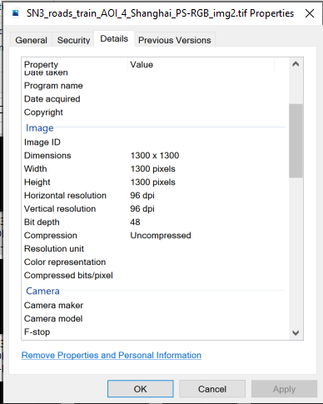
Training Images
For each pan-sharpened Image:
1300 x 1300 pixels.
Each pixel has a spatial resolution of
0.31m x 0.31m.
Each tile is, therefore, 400m x 400m.
Bit depth is 48, so 16 bit for each band, and the value of a pixel in each band is from 0 to 65535.

Slide 8
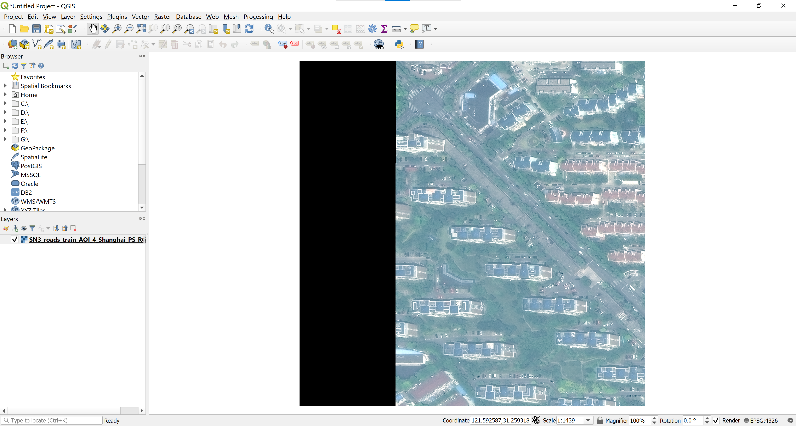

Slide 9
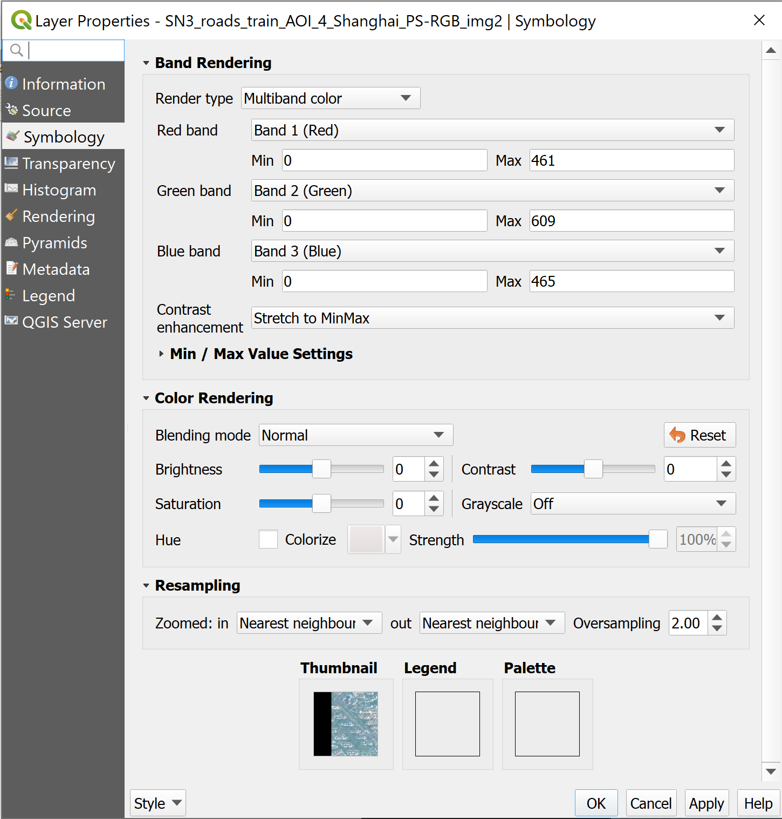

Slide 10
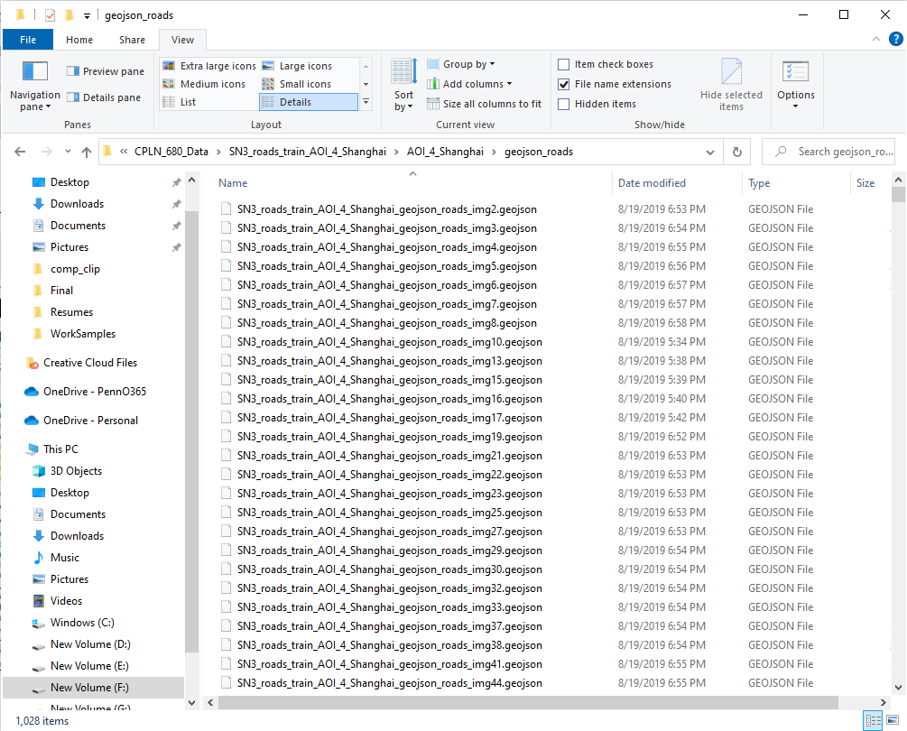
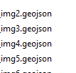
Training Images
Labels
.geojson files stores strings (roads) as
ground truth.

Slide 11
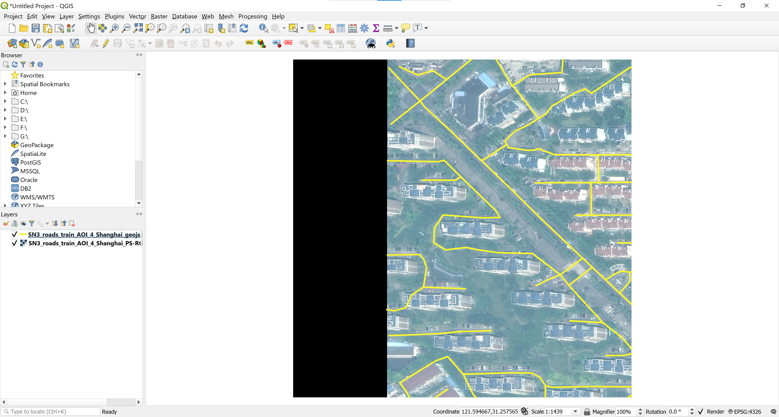

Slide 12

Training Images
Training Labels
The number of .geojson files doesn’t match the number of images.

Slide 13
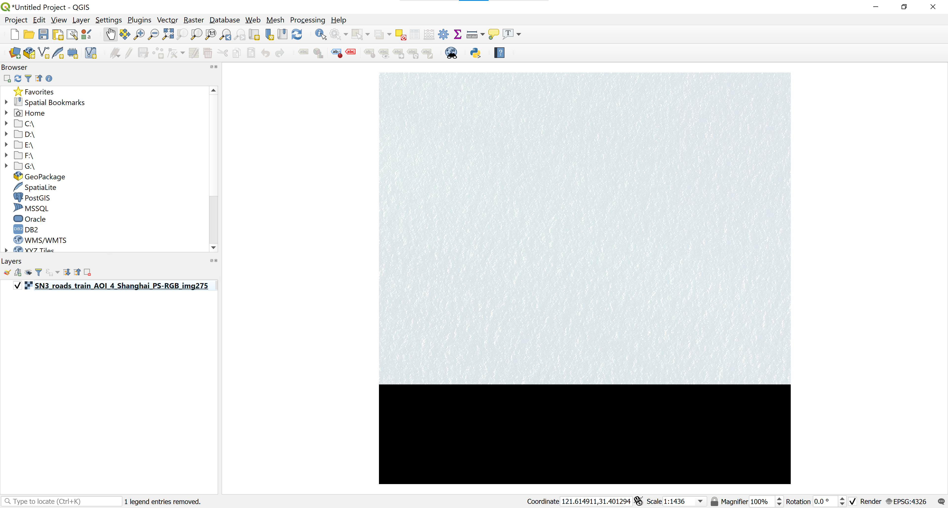

Slide 14
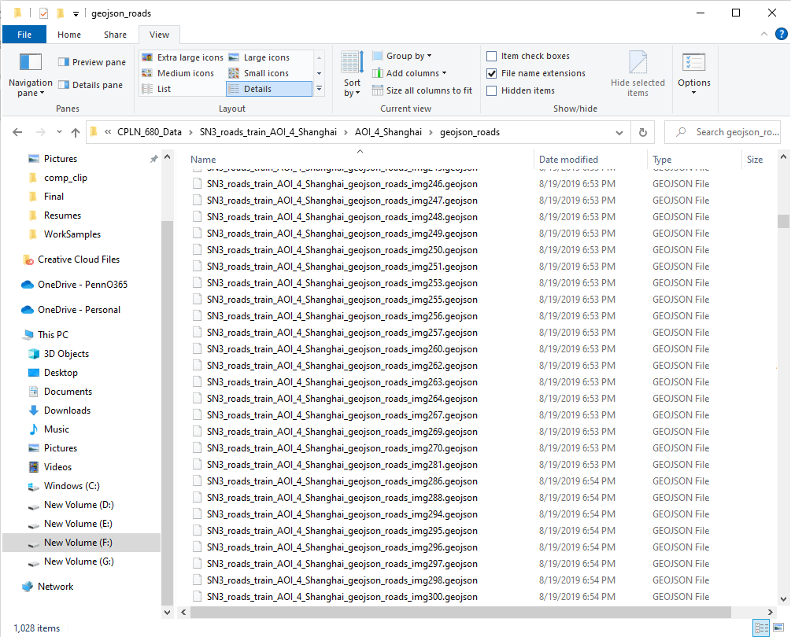
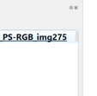
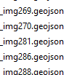

Slide 15
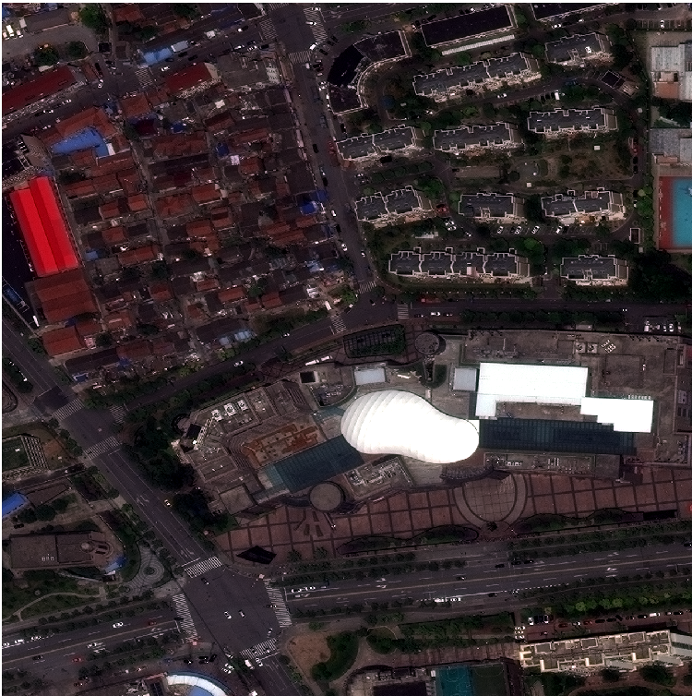
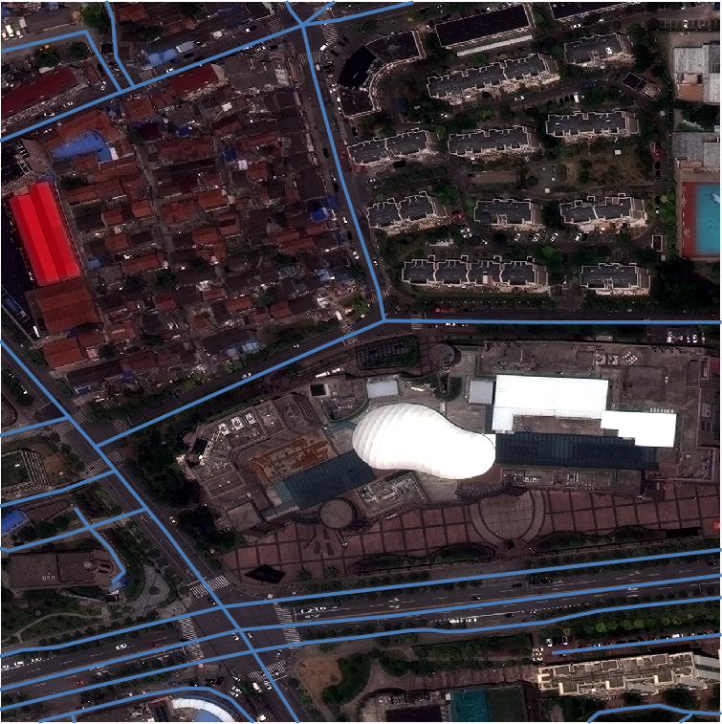

Slide 16
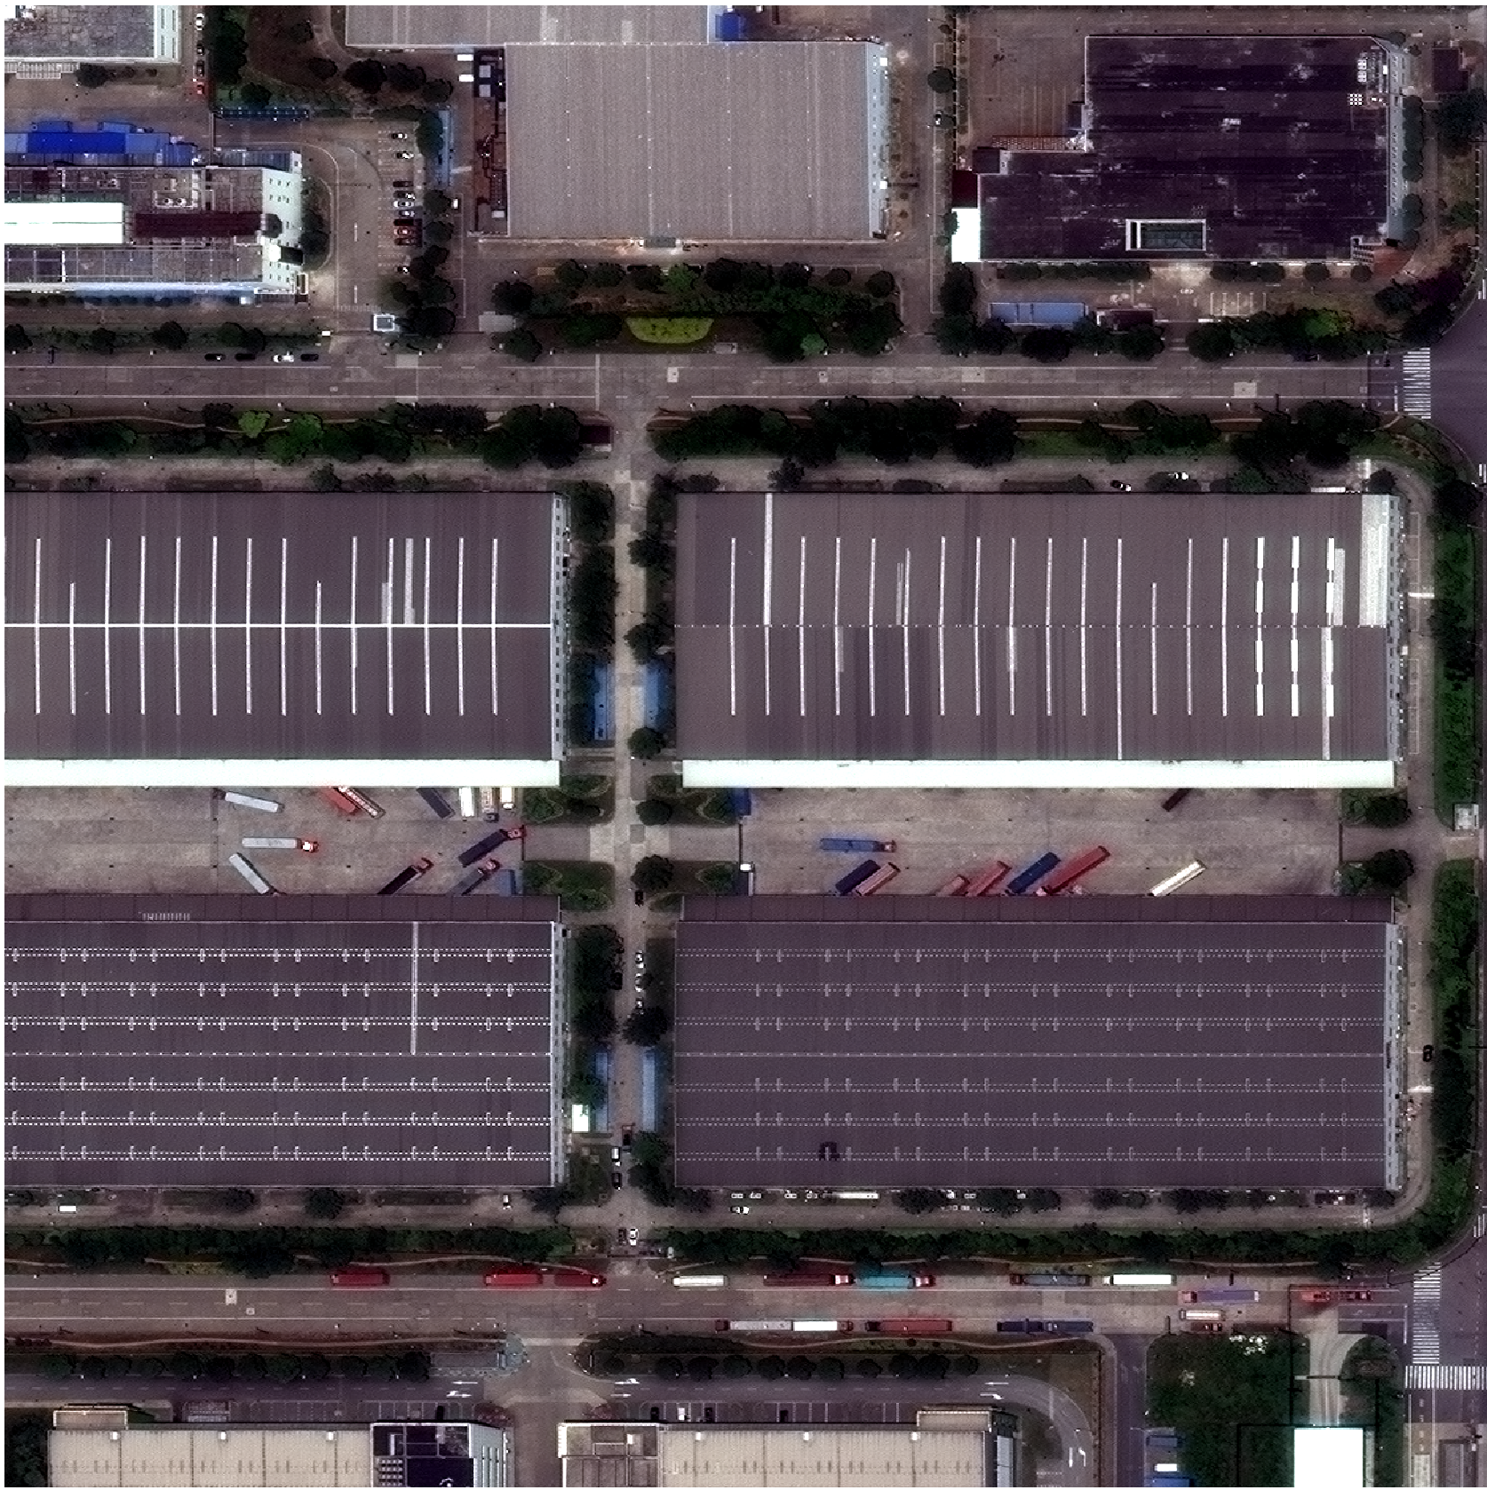
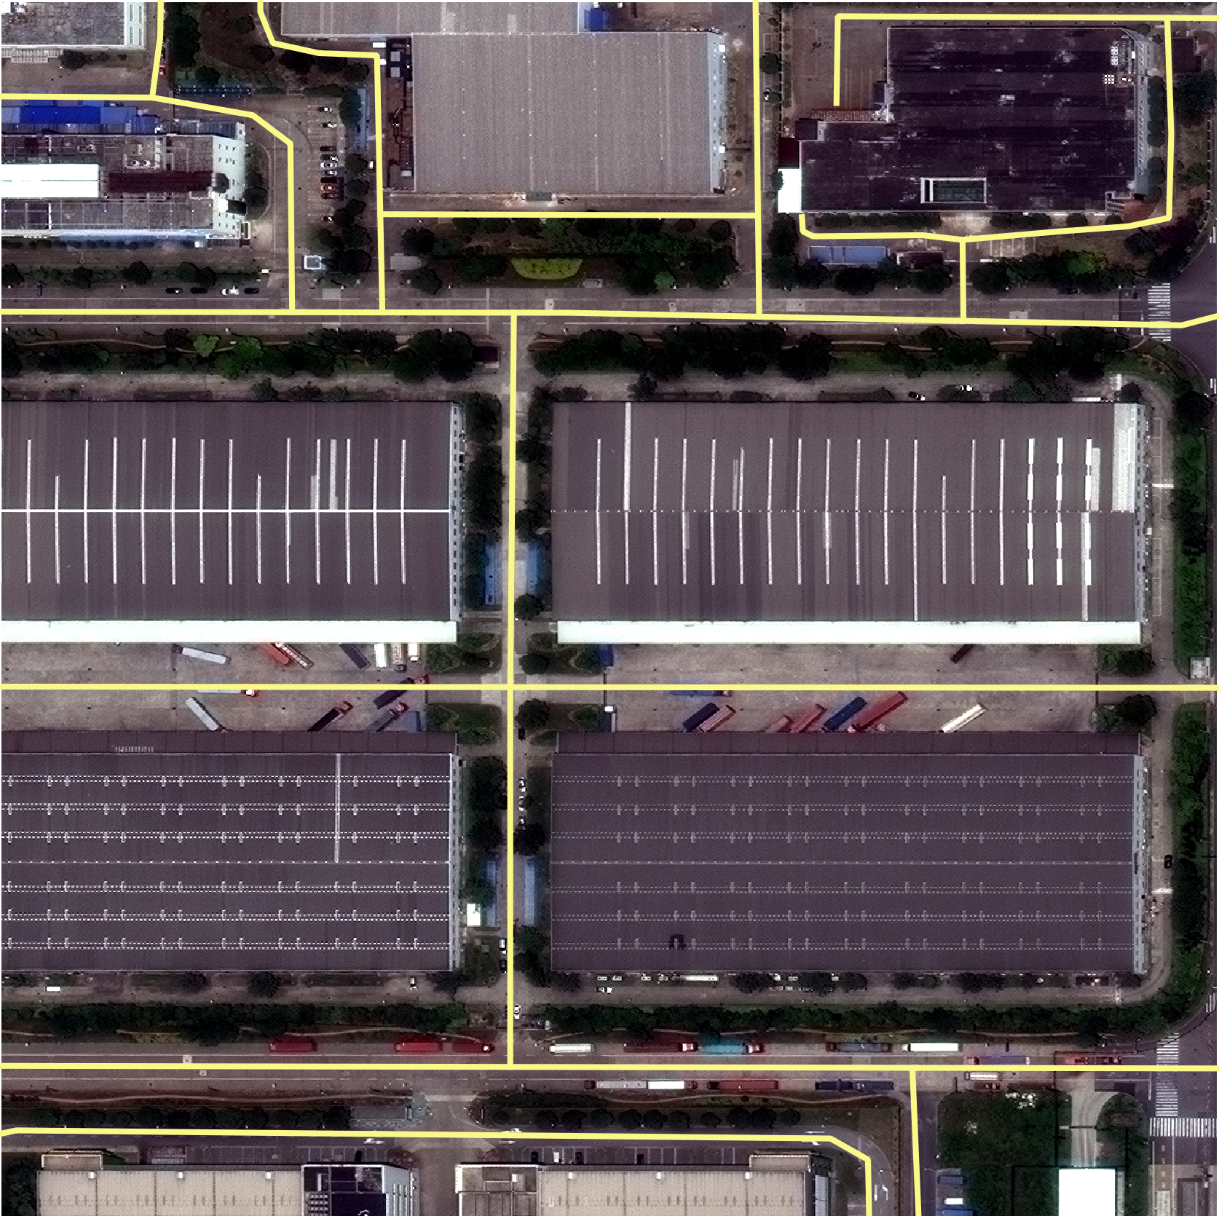

Slide 17
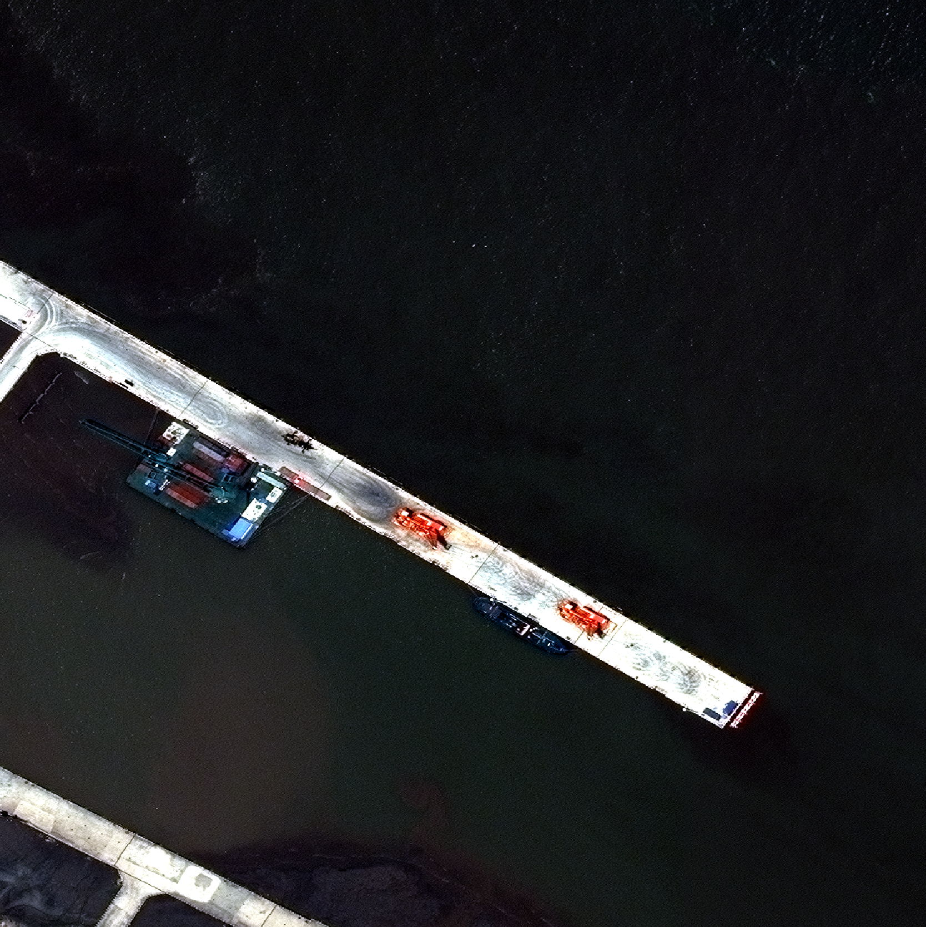
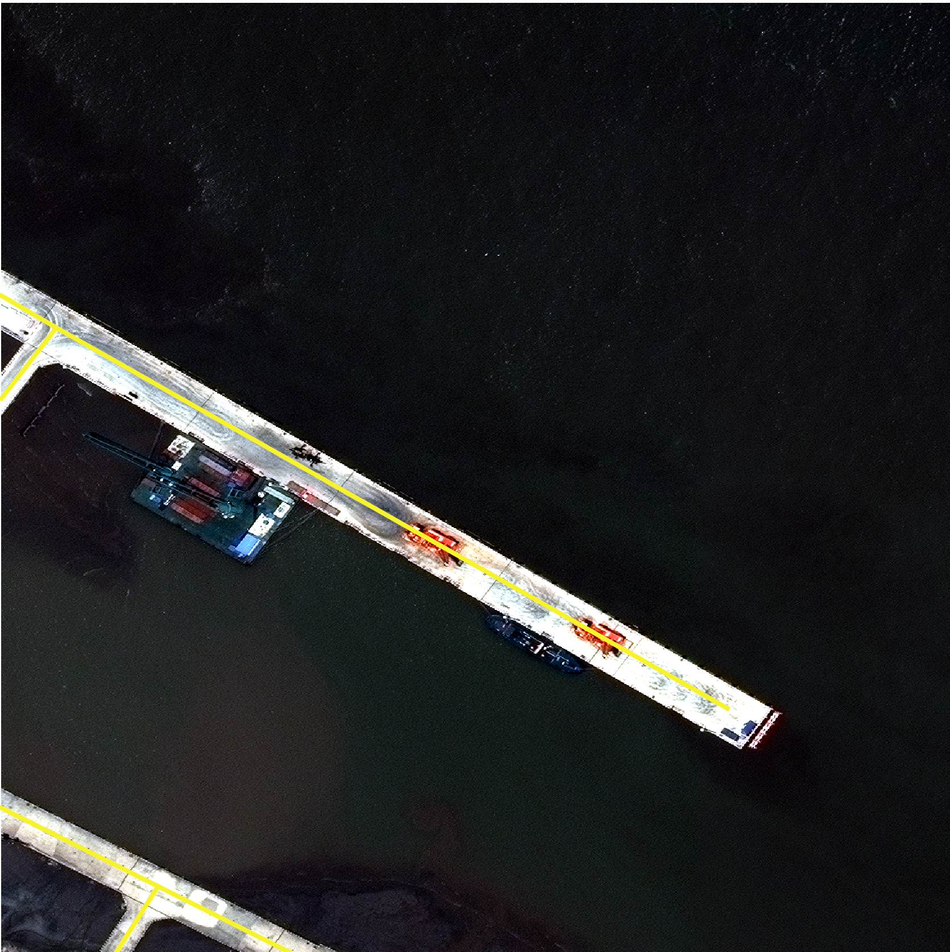

Slide 18
Next Steps
Figure out how to import 48-bit images as arrays into Python.
Generate another dataset containing OSM information which can potentially help with the training processes.
Thank you!

